Slide 1

DELE CA2 Part A
By: Lim Jun Yi, Randal Hong

Slide 2
Task
Apply some suitable GAN architectures to the problem of image generation.
Create 260 small black-and-white (greyscale) images

Slide 3
Preprocessing (EDA)

Slide 4
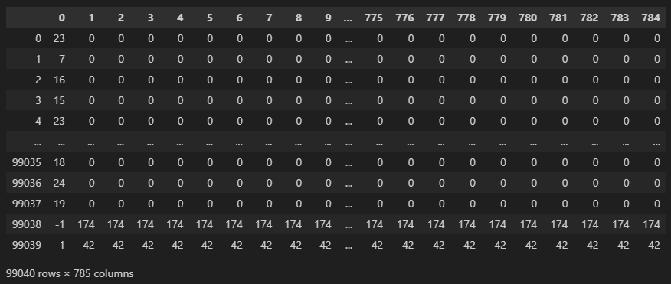
Loading
There are 785 different columns, and 99040 different rows.
We hypothesized that column [0] contains all the labels which identifies which alphabet the image would represent in its number-letter correspondence (with -1 representing a blank image) and the rest of the columns are pixel values.
Hence for each row, we have 1 label value and 784 pixels values which can be nicely reshaped into a 28x28 image.

Slide 5
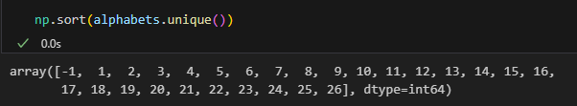
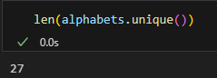
Identifying Classes
There are 27 different classes in the dataset with the values ranging from 1 to 26 (Inferring to the 26 different alphabets in the English alphabets) and a -1.
Let's try to find out what -1 represents and whether labels 1-26 are the alphabets' number-letter correspondence by plotting them out as images.

Slide 6
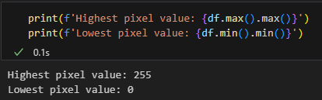
Pixel Values
The pixel values of the dataset ranges from 0 to 255 which confirms our hypothesis that the columns [1-785] are pixel values.

Slide 7
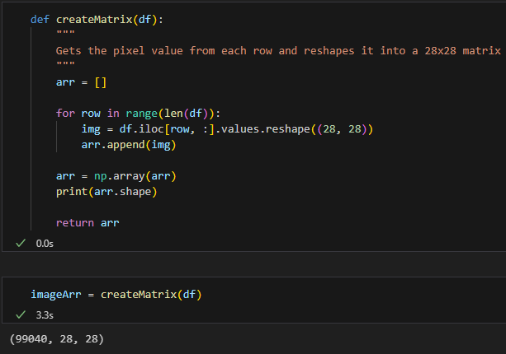
Reshape
Knowing that 784 pixels values can be nicely reshaped into a 28x28 image, we will reshape the columns [1-785] into 28 x 28 to transform all the rows into images.

Slide 8
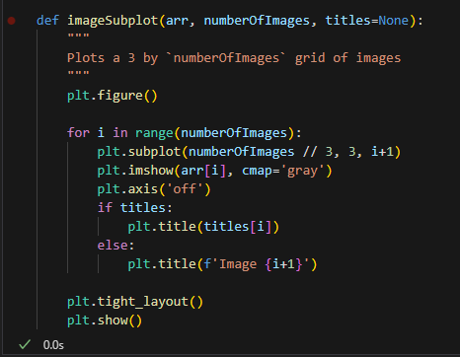
Plotting Image
We implemented a function specifically for image plotting, which makes it more convenient and efficient to create plots in subsequent steps.

Slide 9
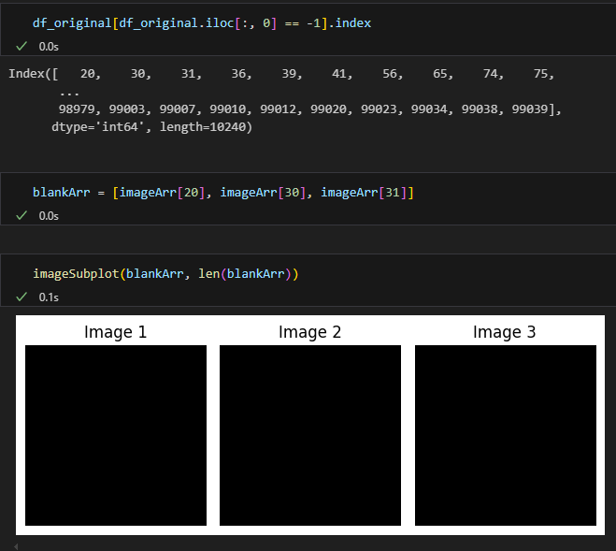
Images (Class -1)
Plotting the first 3 images of the class -1, we can observe that the images of class -1 are blank images (more specifically images that are only filled with 1 pixel value for all 784 pixels).

Slide 10
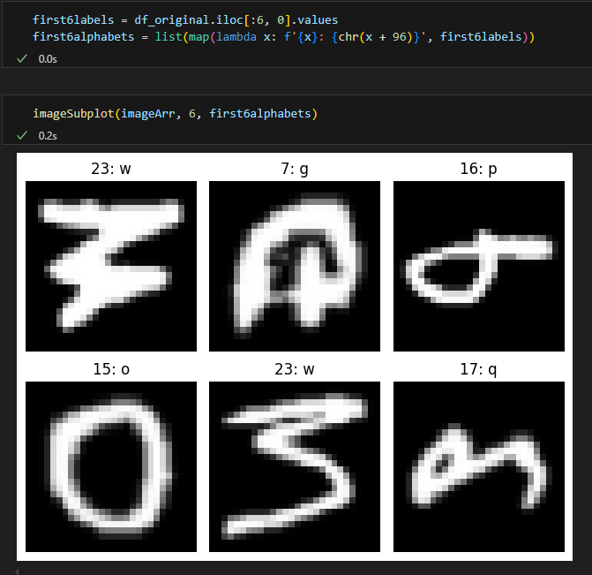
Images (Class 1 – 26)
From the plotted images, we observe that images labelled 1-26 are the number-letter correspondence of the English alphabets.
Hence, we can conclude that the labels 1-26 are the alphabets' number-letter correspondence.
However, we can see that our alphabets look slightly off. This is because the images are not in the correct orientation. We need to transpose them to the correct orientation (rotate 90 degrees clockwise + flip horizontally). We will do that by updating our createMatrix() function.

Slide 11
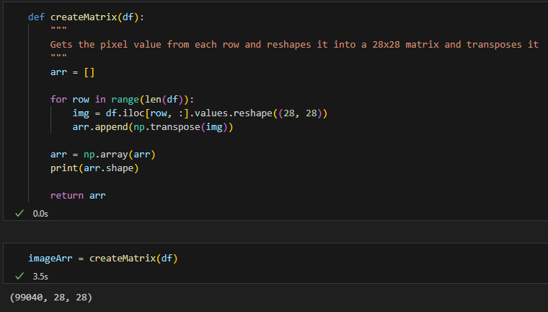
Transformation
Here’s the createMatrix() function that will allow the images to be transformed into the correct orientation (rotate 90 degrees clockwise + flip horizontally).

Slide 12
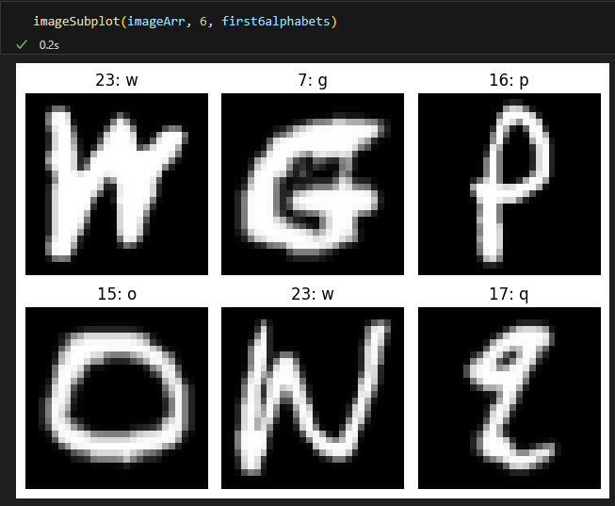
Images (aft. Transformation)
After transforming the images into the supposedly correct orientation, the images are looking like actual letters, and we also can identify which letters belong to which classes.

Slide 13
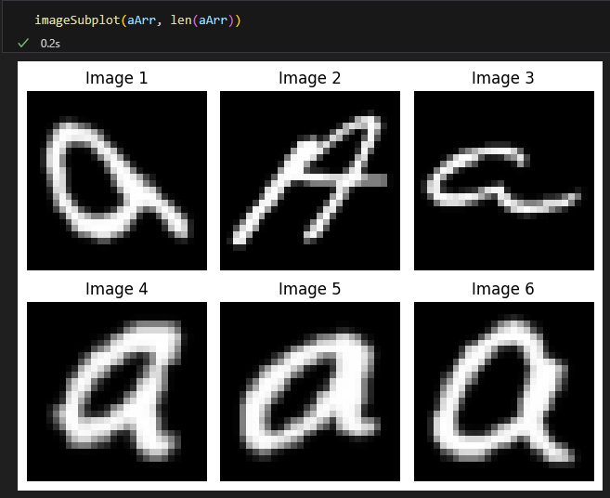
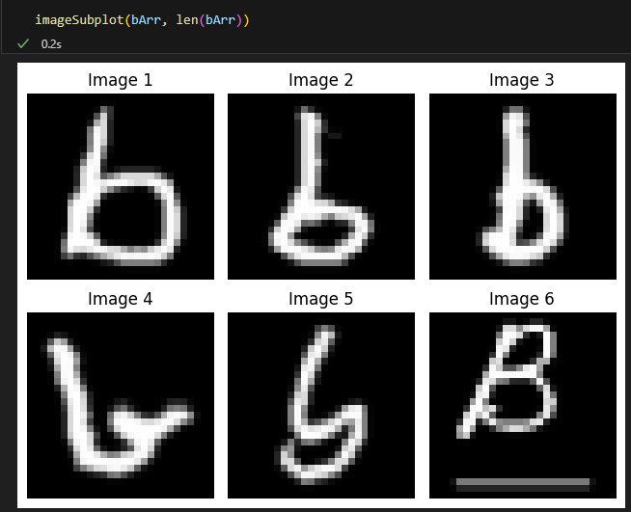
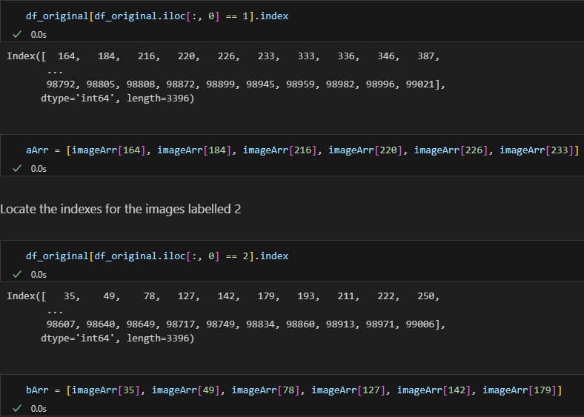
Images (Visualizing selected classes)
Code:
There’s both uppercase and lowercase letters!

Slide 14
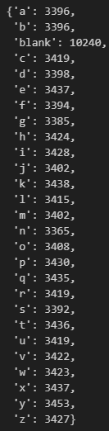
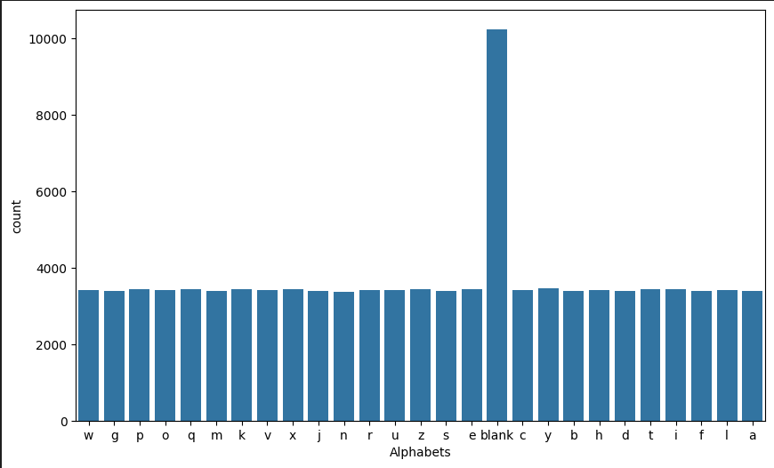
Distribution of Classes
We’ve noticed that the blank class (-1) has a significantly higher number of images compared to the other classes.
Given that the blank images constitute over 10% of the entire dataset, it makes sense to remove blanks to prioritize our main task of alphabet images.
Percentage between number of blank images and the total number of images.

Slide 15
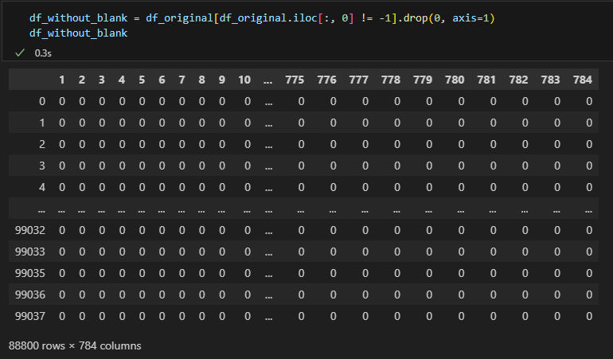
Removal of Class -1
Since our task is to generate images of alphabets and not blank images, we decide to remove the entirety of the -1 class.

Slide 16
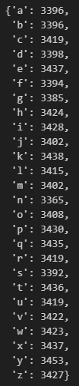
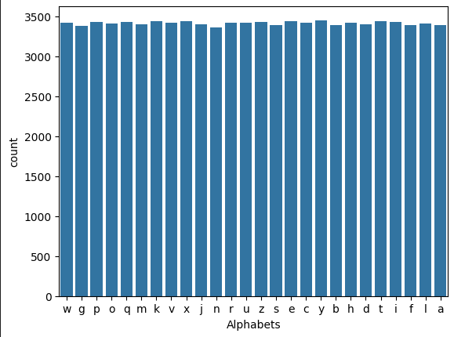
Distribution (aft. Removal of -1)
After removing the -1 class, we will analyse the distribution of all the alphabet letters. This is to ensure that there are no class imbalance in the data, which may affect the biasness of our model during training.
There are not significant biases out of the 26 classes.

Slide 17
Model training

Slide 18
Overview
We have chosen 2 GAN architectures: DCGAN & CGAN
DCGAN (Deep Convolutional Generative Adversarial Network)
DCGAN uses deep convolutional network (Convolutional and Convolutional-transpose layers) in both the discriminator and generator.
CGAN (Conditional Generative Adversarial Network)
In CGAN, both the generator and discriminator receive additional information (e.g. labels) to allow the generation of images conditioned on specific labels or features.

Slide 19

Overview (Metrics)
We will be training both a base model and a hypertuned model of DCGAN and CGAN, comparing results using:
“By eye” or “Eye Power”
Discriminator and Generator Loss (Not a good metric)
I will be mainly using “Eye Power” to evaluate whether the images produce are of quality and thus evaluate the model of its performance.

Slide 20
Overview (Metrics)
We have explored two other metrics that seemed to be useful for the evaluations of the models. However, we decided that it’s best not to use them as they may not be appropriate for our use case.
Fréchet inception distance (FID)
The Inception v3 network used for FID computation is trained on RGB images from the ImageNet dataset, which consists of diverse, complex, high-resolution (299x299) images. The features it extracts are tailored to such images, not to simple, low-resolution (28x28) grayscale images of handwritten alphabets such as our task at hand. Hence, they may not be meaningful or relevant for evaluating the quality of handwritten alphabets as the network's pre-trained filters are not optimized for such simple and small-scale images, leading to unreliable FID scores.
FID also requires images to be resized to 299x299 and converted to three channels (RGB), which introduces distortions and artifacts that can misrepresent the true quality of the generated images. The transformation from 28x28 grayscale to 299x299 RGB is huge and can significantly alter the appearance and features of the images.

Slide 21
Overview (Metrics)
Structural Similarity Index Measure (SSIM)
We tried to use SSIM. However, it is sensitive to small changes in pixel intensity and structure as handwritten alphabets have a high variability. Even minor differences due to different handwritings that are perceptually insignificant to humans can lead to lower SSIM scores.
Generated images also may contain noise or small artifacts that don't significantly affect human perception but can lower the SSIM score. These artifacts might be smoothing, slight distortions, or inconsistencies in pixel intensity.

Slide 22
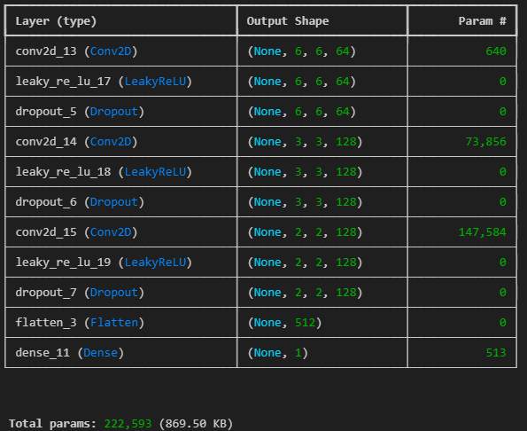
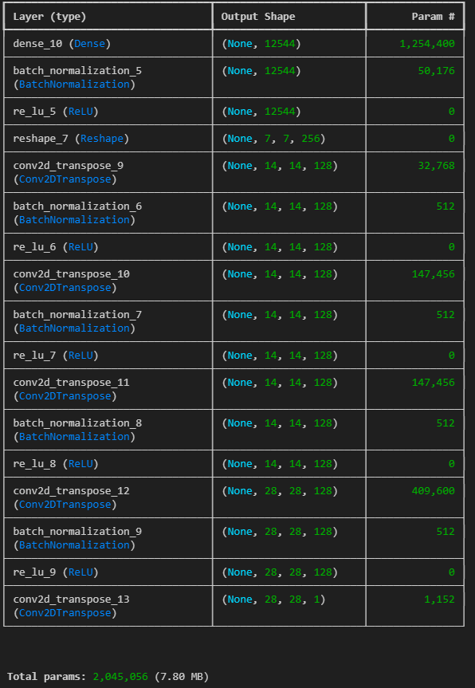
Base DCGAN
Discriminator:
222,593 Params
3 Conv2D layers
Generator:
2,045,056 Params
4 Conv2DTranspose layers

Slide 23
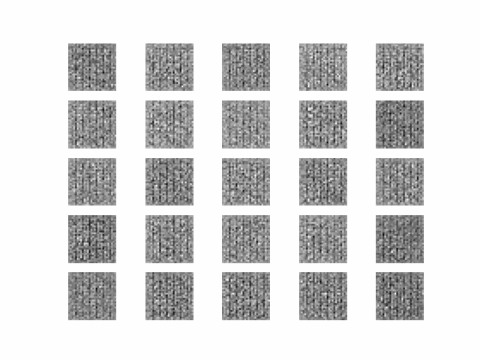
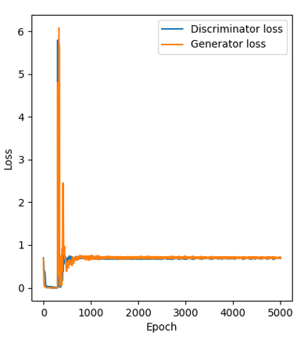
Base DCGAN
Both Discriminator and Generator losses stabilizes after around 800 epochs.
However, loss is not a good indicator on the model’s performance
However, images generated during training has no visible letters. Thus, tuning of model is required.

Slide 24
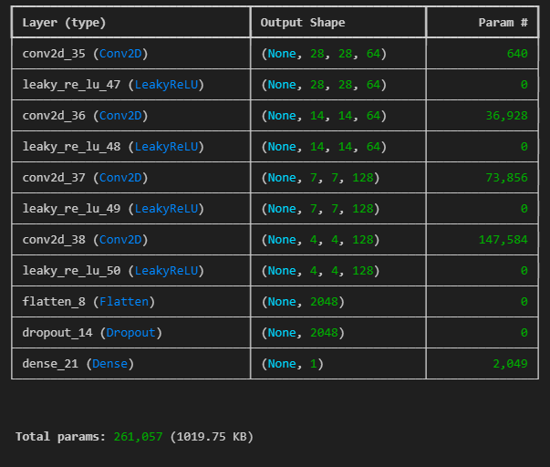
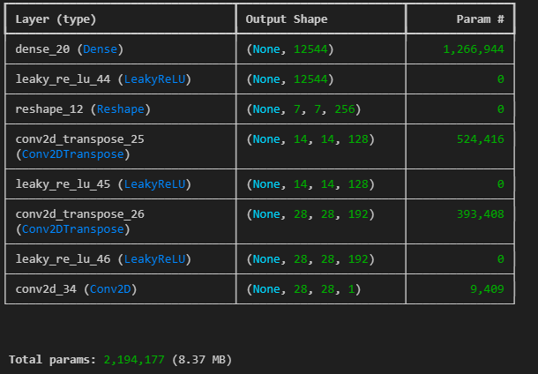
Hypertuned DCGAN
Discriminator:
261,057 Params
4 Conv2D layers
Generator:
2,194,177 Params
2 Conv2DTranspose layers
+ Added another Conv2D Layer
- Removed Batch Norm
+ More neurons in the Conv2DTranspose
+ LeakyRelu

Slide 25
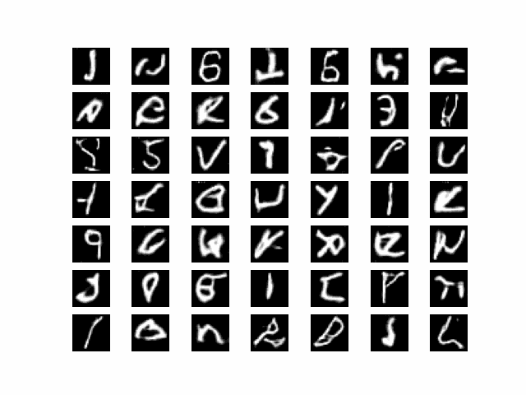
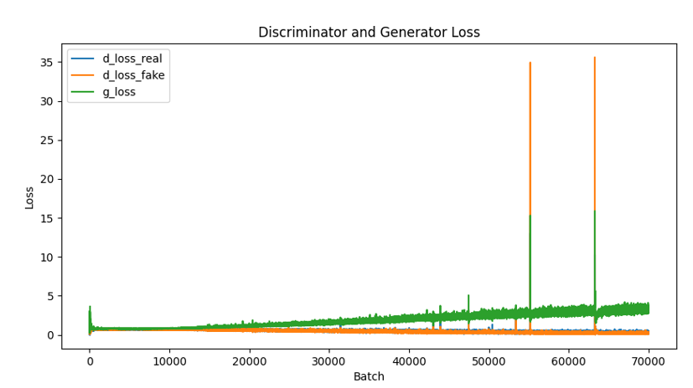
Hypertuned DCGAN
Images generated are looking more like structures of alphabets, but they do not look like actual alphabets.
The loss curves plotted above suggests that the DCGAN is unstable, with a huge spike at around 55000 batch.
(However, previously mentioned that loss is not a good indicator)

Slide 26
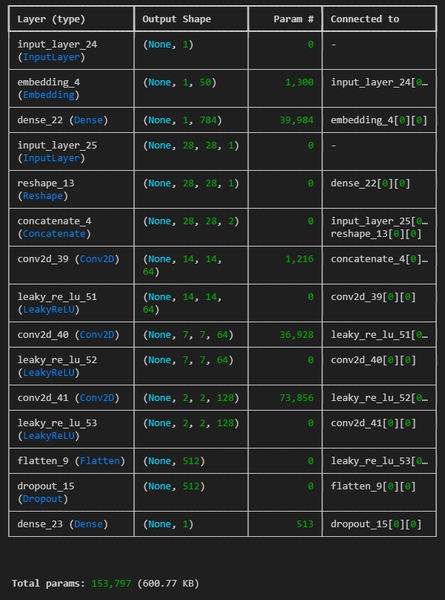
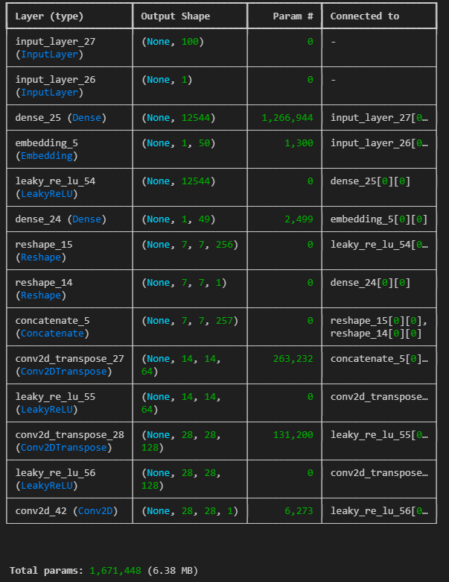
Base CGAN
Discriminator:
153,797 Params
1 Dense layer
3 Conv2D layers
Generator:
1,671,448 Params
2 Dense layers
2 Conv2DTranspose layers
Conv2D as output layer

Slide 27
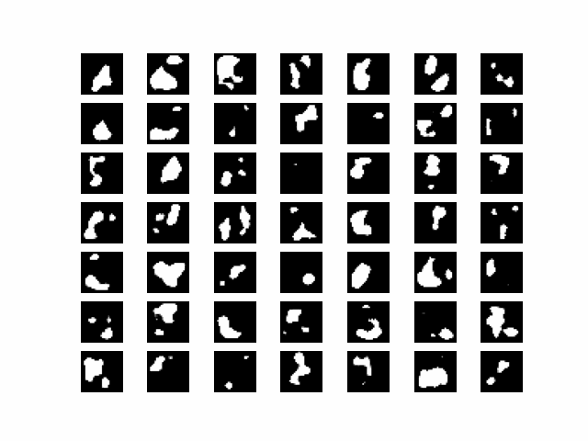
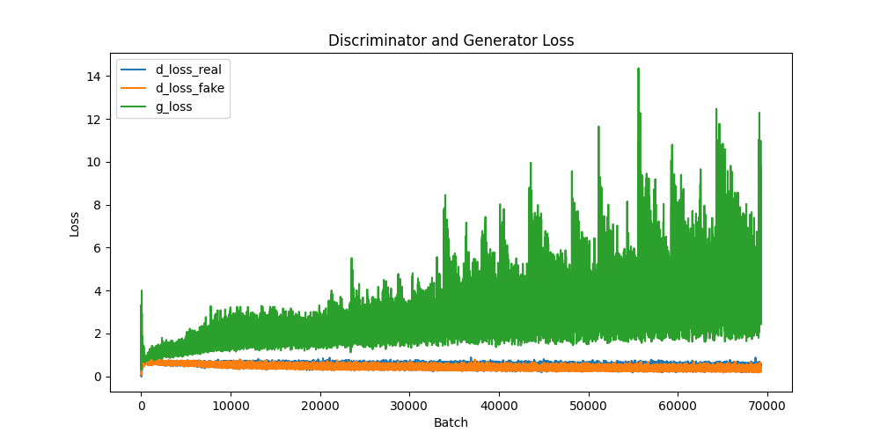
Base CGAN
The loss curves is super unstable.
The generated images are terrible, no visible alphabets or even structures of the any letters are present.

Slide 28
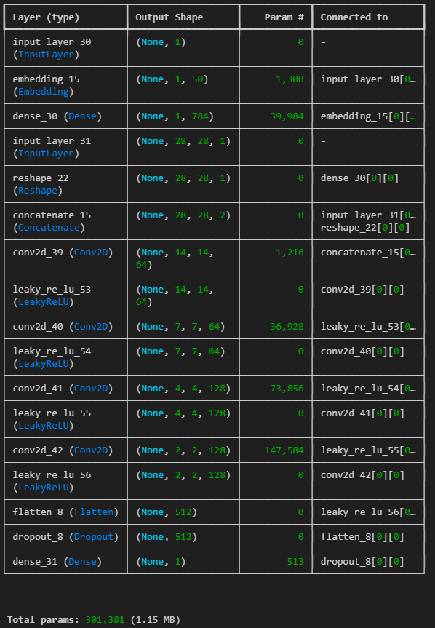
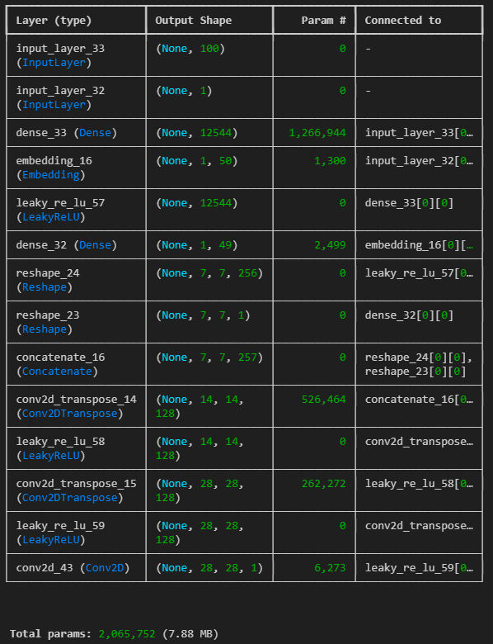
Hypertuned CGAN
Discriminator:
301,381 Params
1 Dense layer
4 Conv2D layers
+ added another Conv2D layer
+ LeakyReLu
+ Dropout
Generator:
2,065,752 Params
2 Dense Layer
2 Conv2DTranspose
+ Increased neurons from 64 to 128 for Conv2DTranpose layers
+ LeakyReLu
+ Dropout

Slide 29
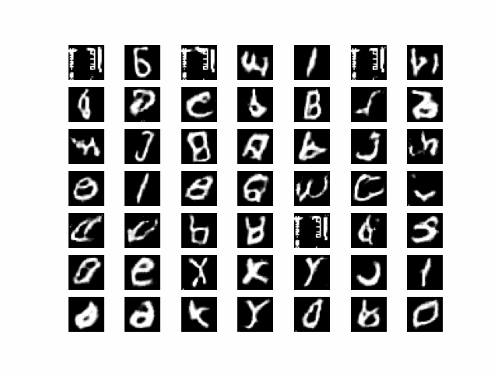
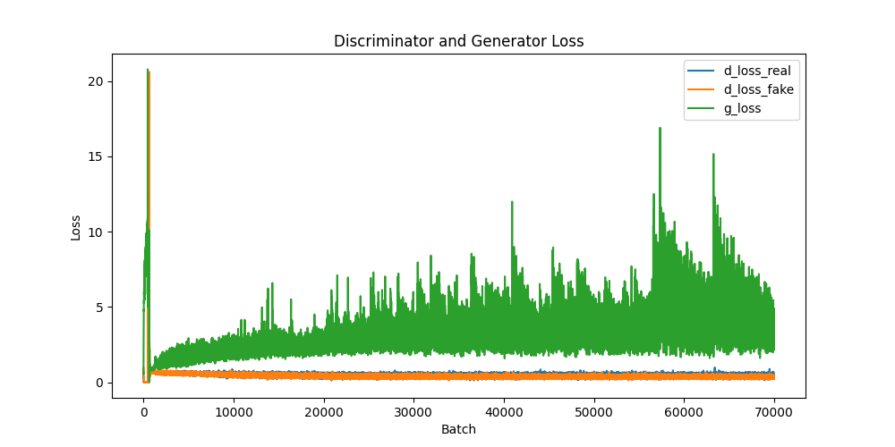
Hypertuned CGAN
The loss curves is very unstable, with a huge splatter of the generator loss plotted on the graph. This also suggests that even though the generated images are looking more real, the loss is not proportional to how well the model is performing.
The images generated now resemble actual alphabets more closely, indicating that the model is performing well.

Slide 30
Evaluation

Slide 31
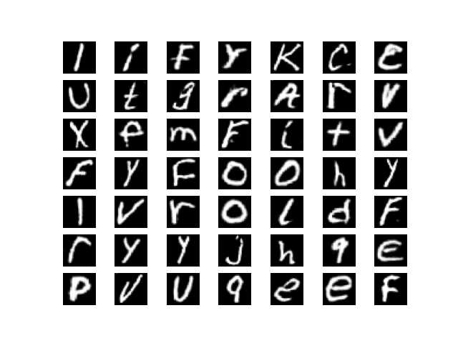
Best GAN Model
Best GAN based on the metrics used: Hyptertuned CGAN
This is the generated image after the CGAN has been trained for 100 epochs, which by far, looks better when compared to all the other models and generated images.
Graph with Discriminator and Generator Loss

Slide 32
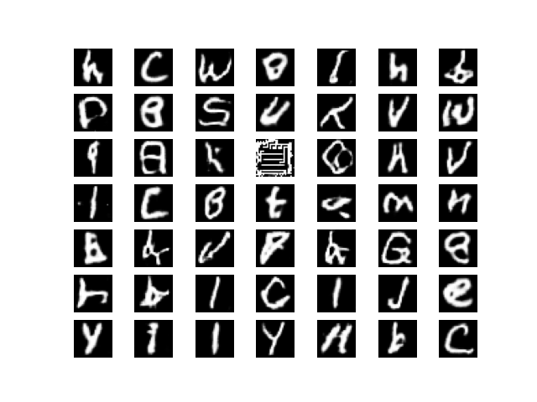

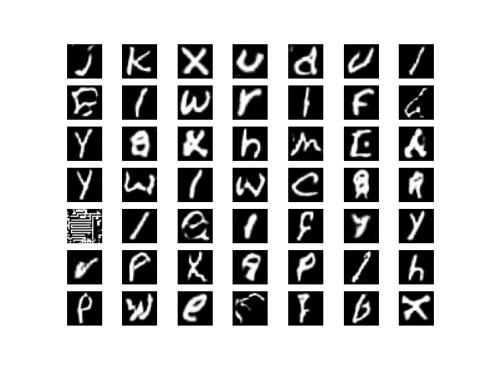
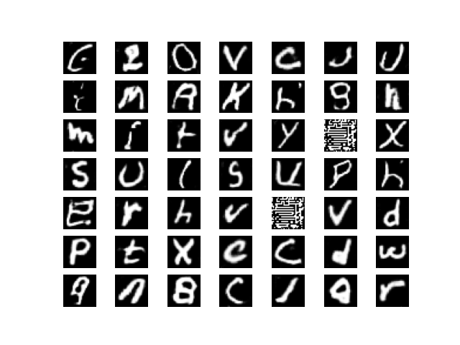
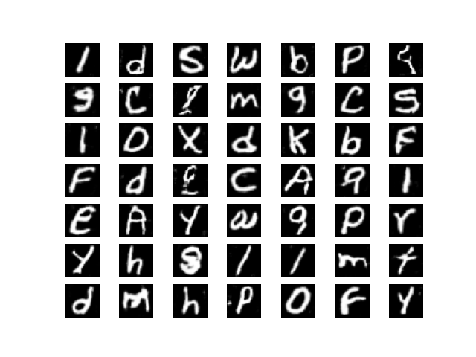
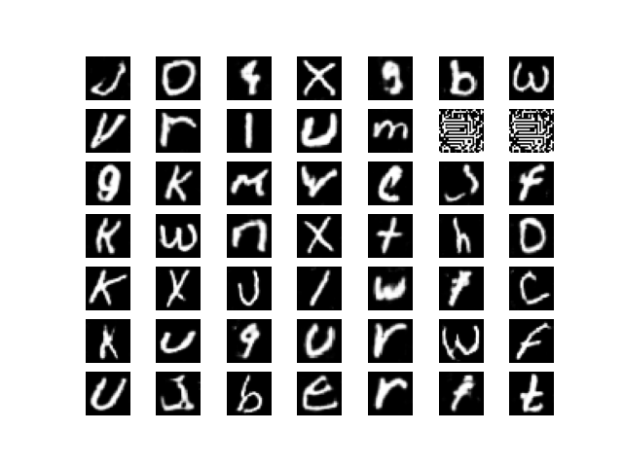
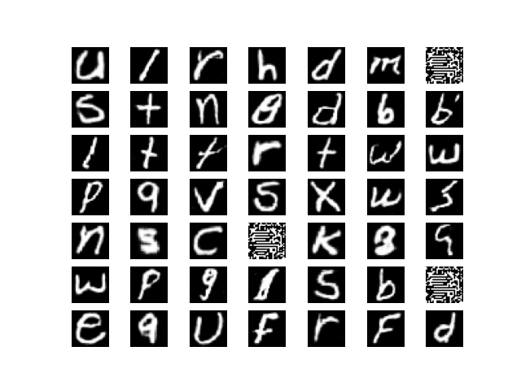
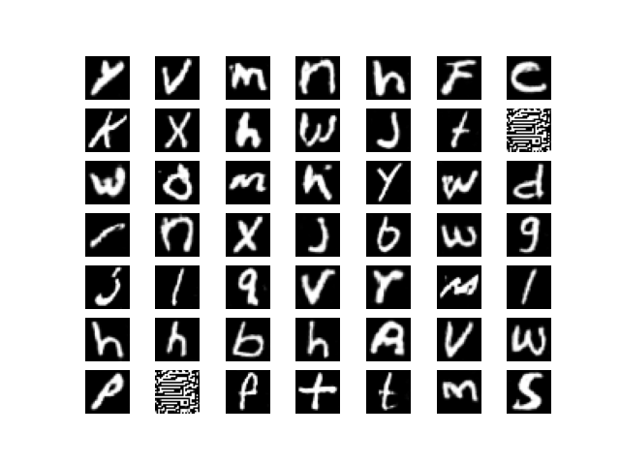
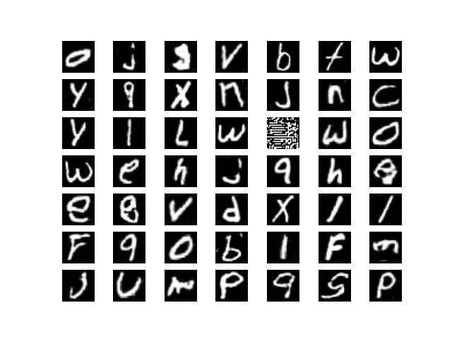
Training Process
10 epochs
20 epochs
30 epochs
40 epochs
50 epochs
60 epochs
70 epochs
80 epochs
90 epochs
100 epochs

Slide 33
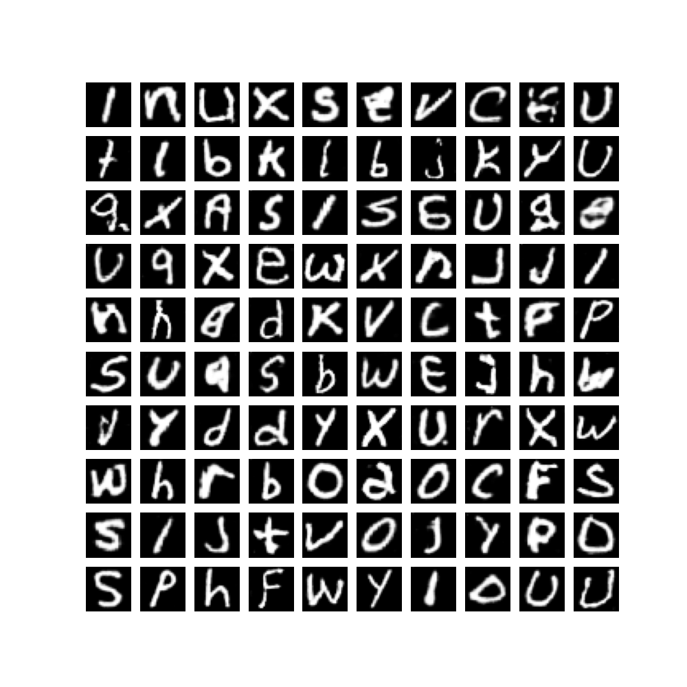
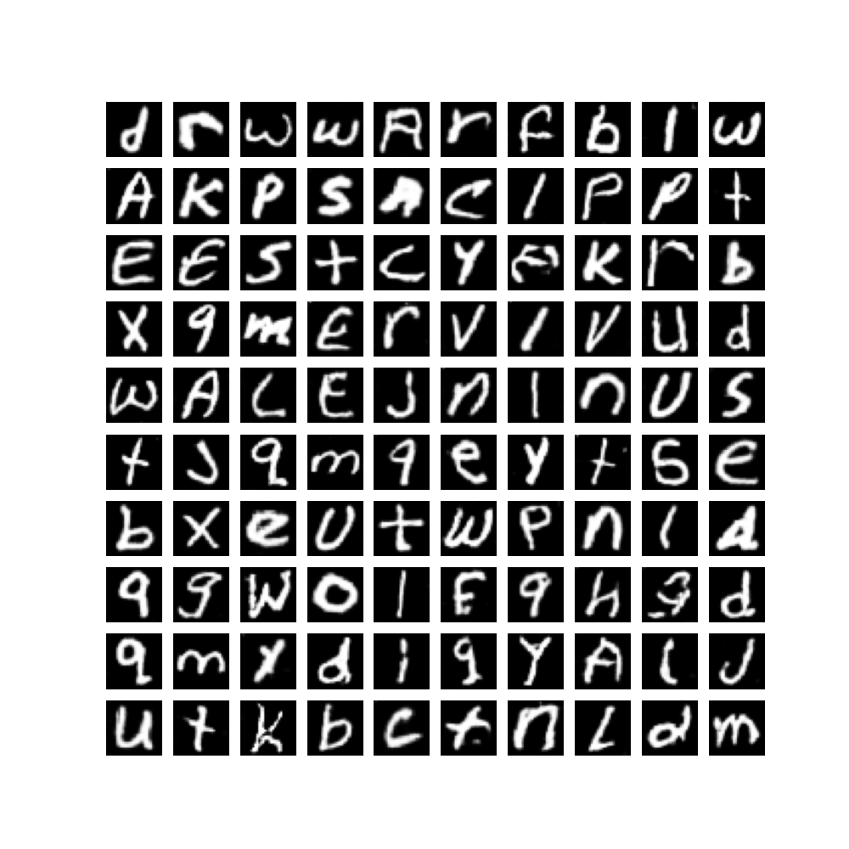
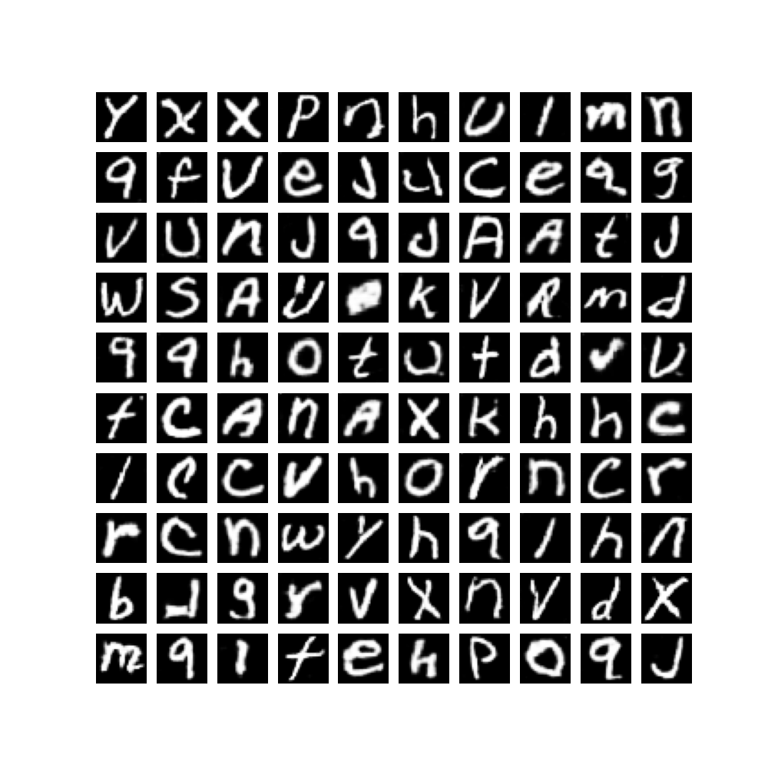
300 generated images

Slide 34
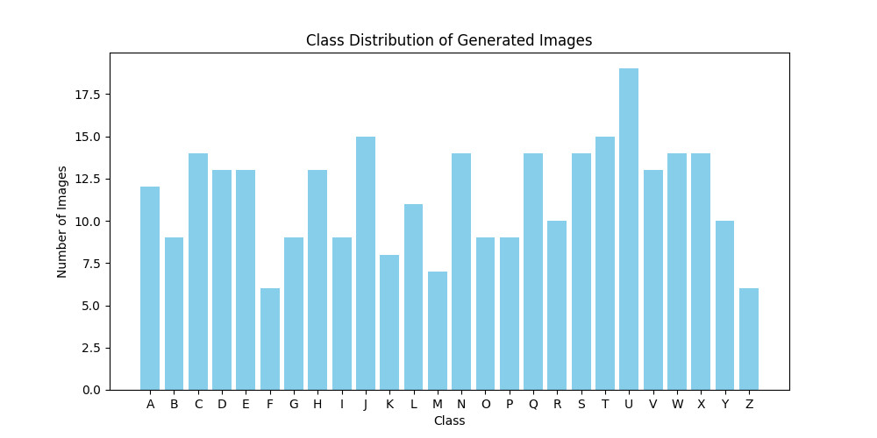
Distribution of generated images
Based on the distribution of the generated image classes, we observe that the letter 'U' is produced most frequently by our model, while the letter 'F' is generated the least.
The top few classes, including 'J', 'C', and 'T', suggest that the model tends to generate letters that are easier to produce. This indicates that the model may prefer generating letters that the model finds less complex to generate.

Slide 35
Questions

Slide 36
If you are asked to generate images of a specific class, propose a way of doing it.
Method 1: Use CGAN. In our CGAN models, since the models are being trained with images and their labels, we can call the model to generate images of a chosen class/label.
Method 2: To train a GAN model with images of a specific class
Method 1 is more efficient as we can generate images from multiple classes without the need to retrain. Method 2 requires 26 different models to generate 26 different classes.

Slide 37
What class(es) is/are relatively easier/harder to generate? Why?
Letters easier to generate include:
- Straight letters: I l L T J V
Letters hard to generate include:
Lookalike letters: B R P b
Curved letters: s S G g c C Q
To judge the difficulty of generating the different classes, we will need to look for:
Complexity of the shape
Variation
Details of the letters

Slide 38
Thank you! Q&A

